Slide 1

ICT502
Week 4: Introduction to Modelling & UML
ICT502 Applied IT Project A
1

Slide 2
Choose two Make-up Session
Dear Students,
We have conducted our first make-up session in week 2 (7th of April) in Class 208 with an option to join online. As next week is a public holiday and we missed the first week session due to campus arrangements, we need to choose two of these time slots: Here are the options, so which two options most of you prefer? If one cannot attend, we will record it. Please communicate with each other and let me know to talk with the campus office about availability of class on those preferred days: 1st option is 21st of April Tuesday 1:30 PM to 4:30 PM --- 2nd option is 24th of April Friday 1:30 to 4:30 PM --- 3rd option is 11th of May Monday 9:30 am - 12:30 pm --- 4th option is 13th of May Wednesday 9:30 am - 12:30 pm Kind regards, Dr. Farshid Keivanian

Slide 3
Choose two Make-up Session
Hi everyone,
I hope you’re all doing well.
I’d like to remind you to complete two important compulsory modules available on the LMS:
1. Academic Integrity Module
2. SASH Course (Sexual Assault and Sexual Harassment)
Both modules are essential and will help you understand your academic responsibilities as well as the support services available to you during your studies.
Please note:
- You will receive a badge after completing each module.
- To earn the badge, you must watch all videos fully (without skipping) and complete the quizzes.
- The SASH course will take around 25–30 minutes to complete.
I will also briefly show you where to find these resources in class and go through them with you.
Please make sure you complete both modules as soon as possible.
Let me know if you have any questions.
Kind regards,
Farshid

Slide 4
An Overview of Assessments
Assessment 2 – GROUP
Initial research + group contract (1500 words, 30%)
This is clearly group-based
It explicitly says: “group contract” and “group members of the team”
Purpose: forming the team + defining project scope
✔ Must be done as a group

Slide 5
An Overview of Assessments
Assessment 3 – INDIVIDUAL
Reflection: Virtual Internships (1000 words, 20%)
This is a personal reflection task
Linked to:
SLO6 (communication skills)
SLO7 (reflection & evaluation)
✔ Must be done individually Cannot be submitted as a group (reflection must be personal)

Slide 6
An Overview of Assessments
Assessment 4 – GROUP
Project Proposal (5000 words, 40%)
This is the main capstone deliverable
Based on:
group project
industry partner work
design and solution documentation
Must be done as a group

Slide 7
Preparation for Assessment 3
Assessment 3: Individual Report 1 – Reflection: Virtual Internships Due: Week 9 (Asked to extend it to Week 10) Weight: 20% Length: about 1000–1200 words Individual or group? Individual

Slide 8
Preparation for Assessment 3
1. What is this assessment really asking you to do?
This assessment is not asking you to just say, “I did a Forage internship and it was good.”
It is asking you to:
Choose and complete one Forage virtual internship
Think carefully about what happened in that internship

Slide 9
Preparation for Assessment 3
3. Reflect on it using two unit learning outcomes:
SLO1: Apply the design process in the development of a project proposal
SLO2: Evaluate effective technology options in the design of an IT project
4. Write a formal report

Slide 10
Preparation for Assessment 3
5. Include your certificate screenshot in Appendix A
6. Use APA referencing
7. Submit one PDF
So this is a reflection + analysis report, not just a summary.

Slide 11
Preparation for Assessment 3
2. What is a “reflection” in simple words?
Reflection means:
What did you do?
What did you notice?
Why did it matter?
What did you learn?
How does it connect to IT project work?
How will it help you in future study or work?

Slide 12
Preparation for Assessment 3
A weak reflection says:
“The internship was useful and interesting.”
A stronger reflection says:
“The internship showed how project work begins with understanding the client problem before choosing tools. This improved my understanding of requirements gathering because I saw that jumping to a technical solution too early can lead to poor project outcomes.”
That is the kind of thinking your lecturer wants.

Slide 13
Preparation for Assessment 3
3. What is The Forage and why is it included in this unit?
The unit outline says you will:
work on an industry-style project
reflect on workplace learning
complete virtual internships

Slide 14
Preparation for Assessment 3
So Assessment 3 is included because it helps you:
understand how professionals work
see how design and decision-making happen in real projects
build communication and employability skills
reflect on experiences that may help future employment

Slide 15
Preparation for Assessment 3
That links strongly to:
SLO6: communication in workplace settings
SLO7: reflection and evaluation for future employment
Even though the task specifically asks you to focus on SLO1 and SLO2, it also supports the broader capstone purpose.

Slide 16
Preparation for Assessment 3
4. How Assessment 3 relates to Assessment 2
Assessment 2
Assessment 2 was about:
initial research
problem identification
project scoping
early design thinking
initial technology exploration
feasibility
group contract

Slide 17
Preparation for Assessment 3
Assessment 3
Assessment 3 is about:
reflecting on a workplace-style virtual internship
noticing how professionals use design processes
evaluating technology choices in a practical context

Slide 18
Preparation for Assessment 3
Simple relationship between them
Assessment 2 = planning stage
Students worked as a group to:
identify a problem
explore possible solutions
think about technology
define project scope

Slide 19
Preparation for Assessment 3
Assessment 3 = reflection stage
Students individually look at a virtual internship and ask:
how do real professionals define problems?
how do they gather requirements?
how do they choose technology?
what can I learn from that for my own IT project work?

Slide 20
Preparation for Assessment 3
Is Assessment 3 an extension of Assessment 2?
Yes, in an academic sense, it is a continuation or extension of the same learning journey.
Not exactly the same task, but it builds on similar ideas.
Assessment 2 focuses on:
your group’s own early project thinking
Assessment 3 focuses on:
reflecting on an industry-like experience and connecting it to project design and technology evaluation

Slide 21
Preparation for Assessment 3
Good sentence students can use:
Assessment 3 can be seen as a continuation of the thinking developed in Assessment 2. In Assessment 2, my group explored an IT problem, initial design ideas, and possible technology options. In Assessment 3, the Forage internship helped me reflect on how similar processes are applied in an industry context, especially in relation to design stages and technology decision-making.

Slide 22
Preparation for Assessment 3
5. What should students do first?
Step 1: Choose the right Forage internship
Pick one that is clearly related to:
IT
software development
data analytics
cybersecurity
system design
business analysis
cloud
digital transformation
solution architecture

Slide 23
Preparation for Assessment 3
Best choice
Choose one where tasks involve things like:
understanding a business problem
gathering requirements
analysing data
suggesting a solution
comparing tools or platforms
making technical decisions

Slide 24
Preparation for Assessment 3
Avoid choosing a program that is too unrelated
For example, if it is mostly legal writing or finance with almost no technology/design element, it may be harder to connect to SLO1 and SLO2.

Slide 25
Preparation for Assessment 3
6. What notes should students take during the Forage internship?
Tell students to make notes while doing the internship.
They should write down:
Basic details
company name
internship/program title
number of modules
estimated duration

Slide 26
Preparation for Assessment 3
Task details
For each module/task:
what was the task?
what problem was being solved?
who was the client/user/stakeholder?
what information was given?
what decision had to be made?
what technologies, tools, platforms, or approaches were mentioned?

Slide 27
Preparation for Assessment 3
Design process clues
Even if Forage does not say “design process,” ask:
Was there problem definition?
Were requirements identified?
Was there planning?
Was a solution proposed?
Was there testing or review?
Was there iteration or improvement?

Slide 28
Preparation for Assessment 3
Technology evaluation clues
Ask:
Were there multiple technical options?
Was a tool/platform selected?
Why was it chosen?
What criteria mattered?
cost?
speed?
security?
scalability?
user need?
integration?
ease of use?

Slide 29
Preparation for Assessment 3
Personal reflection
Ask:
What surprised me?
What was difficult?
What did I learn about workplace decision-making?
How will this help my project work?

Slide 30
Preparation for Assessment 3
7. Step-by-step guide to writing Assessment 3
Section A: Introduction (about 100 words)
What to include
name of company
name of Forage program
estimated duration
purpose of your report
mention SLO1 and SLO2

Slide 31
Preparation for Assessment 3
Simple formula
I completed [program] by [company] on The Forage. The program took approximately [X hours]. This report reflects on the experience with a focus on the design process in IT project development and the evaluation of technology options. The report links the internship to SLO1 and SLO2 of ICT502.

Slide 32
Preparation for Assessment 3
Example 1: Business Analysis / Information Systems
I completed the Business Analyst virtual internship offered by Company X through The Forage. The program took approximately four hours and involved practical tasks such as analysing business needs, identifying stakeholder requirements, and recommending suitable digital solutions. This report reflects on the experience in relation to SLO1, which focuses on applying the design process in project development, and SLO2, which focuses on evaluating effective technology options in an IT project. The report examines how the internship demonstrated structured problem-solving, requirements analysis, and technology decision-making in a business context.

Slide 33
Preparation for Assessment 3
Example 2: Data Analytics
I completed the Data Analytics virtual internship offered by Company X through The Forage. The program took approximately five hours and required tasks such as interpreting business data, identifying patterns, and presenting recommendations to support decision-making. This report reflects on how the internship demonstrated elements of the design process and the evaluation of technology options in an IT-related business environment. In particular, it links the experience to SLO1 and SLO2 by analysing how data-driven problem-solving supports project planning and technology selection.

Slide 34
Preparation for Assessment 3
Example 3: Digital Transformation / Business Technology
I completed the Digital Transformation virtual internship offered by Company X through The Forage. The program took approximately four hours and focused on analysing business challenges, improving processes, and recommending technology-enabled solutions. This report reflects on the experience with reference to SLO1 and SLO2 of ICT502. It analyses how the internship illustrated the design process through problem identification and solution planning, and how technology options were considered in relation to organisational needs and implementation effectiveness.

Slide 35
Preparation for Assessment 3
Example 4: Software / Systems Context but still business-friendly
I completed the Software Engineering virtual internship offered by Company X through The Forage. The program took approximately four hours and involved workplace-based tasks related to analysing user needs, considering system requirements, and proposing technical solutions. This report reflects on the experience in relation to SLO1 and SLO2 of ICT502. It focuses on how the internship demonstrated stages of the design process and how technical options were evaluated in order to support effective project outcomes.

Slide 36
Preparation for Assessment 3
Example 5: Cybersecurity but less technical in tone
I completed the Cybersecurity virtual internship offered by Company X through The Forage. The program took approximately four hours and involved tasks related to identifying risks, understanding organisational needs, and recommending appropriate security measures. This report reflects on the experience through the lens of SLO1 and SLO2 of ICT502. It analyses how the internship demonstrated structured problem analysis and how security technologies or approaches can be evaluated according to business requirements, risk, and effectiveness.

Slide 37
Preparation for Assessment 3
Hint
Do not write too much here. Keep it short and direct.

Slide 38
Preparation for Assessment 3
Section B: Overview of the Forage Program and Key Tasks (about 200 words)
What to include
overall purpose of the internship
summary of main modules/tasks
identify which tasks connect to project design or technology selection

Slide 39
Preparation for Assessment 3
Questions to help students
What was the internship trying to teach?
What were the main tasks?
Which tasks involved analysing a problem?
Which tasks involved choosing or recommending a solution?

Slide 40
Preparation for Assessment 3
Example points
Module 1: analyse client needs
Module 2: propose a technical solution
Module 3: compare options/tools
Module 4: present findings

Slide 41
Preparation for Assessment 3
Example sentence
The overall purpose of the program was to simulate how professionals respond to a client or business problem using structured analysis and technical reasoning. Key tasks included reviewing the problem scenario, identifying business needs, analysing available data, proposing a solution, and justifying technical decisions.

Slide 42
Preparation for Assessment 3
Hint
This section is mainly descriptive, but still be selective. Only mention the most important tasks.

Slide 43
Preparation for Assessment 3
Section C: Application of the Design Process (SLO1 Focus) (about 400 words)
This is one of the most important sections.
What “design process” means in simple terms
In IT, a design process often includes:

Slide 44
identifying the problem
understanding user/stakeholder needs
gathering requirements
planning and analysing
designing a solution
testing or reviewing
improving/iterating
Even if the internship did not use these exact words, you should still identify them.

Slide 45
What students must do here
They need to choose at least two tasks or scenarios and explain:
what happened in the task
which part of the design process it shows
why that matters in project development

Slide 46
Good structure for each task
Task 1
What was the task?
Which stage of design process does it show?
How?
Why is that important?
Task 2
Same method

Slide 47
Example analysis
Suppose a task asked the student to review a business case and identify the client’s problem.
That can be linked to:
problem definition
stakeholder analysis
requirements elicitation
business process analysis
governance review
risk identification

Slide 48
Example wording
One important design stage demonstrated in the internship was problem definition. In one task, I had to examine the client scenario and identify the core issue before suggesting any solution. This reflects the early design process used in IT projects, where clearly defining the problem is essential before moving into solution planning. Without this stage, a project team may build something technically impressive but irrelevant to user needs.

Slide 49
Example 1: Business process problem
Suppose a task asked the student to examine an inefficient workflow in a company.
That can be linked to:
problem definition
process analysis
stakeholder needs
requirements gathering

Slide 50
Example wording
In one task, I had to review an existing business process and identify where inefficiencies were occurring. This reflected problem definition and requirements analysis because the aim was to understand the current process before proposing changes. In business information systems projects, this stage is important because system improvements should be based on real operational problems rather than assumptions.

Slide 51
Example 2: System recommendation task
Suppose a task asked the student to recommend a system, such as CRM, ERP, or reporting platform.
That can be linked to:
conceptual design
solution modelling
planning
alignment between business needs and system features

Slide 52
Example wording
Another task reflected conceptual design because I was required to recommend a suitable information system based on the organisation’s needs. Although the internship did not explicitly call this a design stage, it involved translating business requirements into a possible system solution. This is a key part of business information systems design, where the goal is to align technology capabilities with business objectives.

Slide 53
Example 3: Stakeholder-focused analysis
Suppose a task asked the student to compare the needs of different departments.
That can be linked to:
stakeholder analysis
requirements elicitation
scope clarification

Slide 54
Example wording
One scenario required me to consider the needs of different stakeholders, such as management, staff, and customers. This reflected stakeholder analysis and requirements elicitation because each group had different expectations from the system. The task showed that an effective project design process must consider multiple perspectives before finalising a proposed solution.

Slide 55
Example 4: Data/reporting decision
Suppose a task involved dashboards, reporting tools, or decision support systems.
That can be linked to:
requirements gathering
conceptual design
information needs analysis

Slide 56
Example wording
A task involving reporting and data presentation also demonstrated the design process. I had to think about what information decision-makers needed and how that information should be delivered. This connected to requirements gathering and conceptual design because the proposed reporting solution had to match business needs and user expectations.

Slide 57
More examples for IT Governance students
Example 5: Risk and control review
Suppose a task asked the student to identify risks, compliance concerns, or control weaknesses.
That can be linked to:
problem identification
governance analysis
risk assessment
requirements for control and compliance

Slide 58
Example wording
One important task involved identifying risks and control weaknesses in an organisational scenario. This reflected the early design process because it required understanding the governance problem before considering an appropriate solution. In IT governance, design decisions must be informed by risk, accountability, and compliance requirements, not only by operational efficiency.

Slide 59
Example 6: Policy or compliance improvement
Suppose a task required reviewing policies or suggesting governance improvements.
That can be linked to:
requirements analysis
planning
organisational design considerations
alignment of IT practices with governance standards

Slide 60
Example wording
Another task involved reviewing existing practices and suggesting improvements to policy or compliance processes. This can be linked to planning and requirements analysis because the task required identifying what the organisation needed in order to improve governance outcomes. It showed that effective IT project design is not limited to technical system building, but also includes designing processes and controls that support responsible technology use.

Slide 61
Example 7: Aligning IT with business strategy
Suppose a task asked the student to recommend a governance or technology approach that supports business goals.
That can be linked to:
problem definition
strategic alignment
conceptual design
evaluation of organisational needs

Slide 62
Example wording
In one scenario, I had to consider how an IT-related decision could support broader business objectives. This reflected conceptual design because the task was not just about choosing a tool, but about planning a suitable approach that aligned technology with organisational strategy. This is especially relevant in IT governance, where technology decisions must support accountability, risk management, and long-term business value.

Slide 63
What else to discuss
Students should also say:
which design stages were strong in the internship
which stages were missing or less visible

Slide 64
Example
The internship clearly demonstrated problem analysis and conceptual solution design. However, prototyping and iterative testing were less visible. In a real-world IT project, these stages would be important because they help validate whether the proposed solution actually works in practice.

Slide 65
Final reflection for this section
Students should end by saying:
how this improved their understanding of developing a project proposal
Example
This experience improved my understanding that project proposals should not begin with tools or coding. Instead, they should start with a clear problem, identified requirements, and a structured design process that links user needs to a realistic solution.

Slide 66
Business Information Systems Example
This experience improved my understanding that project proposals in business information systems should not begin with selecting software too quickly. Instead, they should begin with a clear understanding of the business problem, stakeholder needs, and process requirements so that the proposed system is both useful and realistic.

Slide 67
IT Governance version example
This experience improved my understanding that project proposals in IT governance should not begin with a technology choice alone. They should begin with a clear understanding of organisational risks, governance needs, compliance expectations, and strategic goals so that any proposed solution is effective, accountable, and aligned with the business context.

Slide 68
Extra examples for IT Governance and Business Information Systems students
If your Forage internship is more business- or governance-focused, you can still analyse it using the design process. For example:
reviewing an inefficient business workflow → problem definition, process analysis, requirements gathering
comparing stakeholder needs across departments → stakeholder analysis, requirements elicitation

Slide 69
recommending a CRM, ERP, or reporting system → conceptual design, planning, solution modelling
identifying risks or control weaknesses → problem identification, governance analysis, risk assessment
reviewing policy or compliance issues → requirements analysis, planning, governance design

Slide 70
aligning IT decisions with business strategy → conceptual design, strategic alignment, solution planning
These examples show that the design process is not only about coding or technical architecture. It can also apply to business processes, governance structures, enterprise systems, and organisational decision-making.

Slide 71
The design process in ICT502 should be understood broadly. It does not only apply to software coding or technical system architecture. For business information systems and IT governance students, it may also involve analysing organisational problems, understanding stakeholder needs, improving business processes, designing controls, supporting compliance, or aligning IT decisions with business strategy.

Slide 72
Section D: Evaluation of Effective Technology Options (SLO2 Focus) (about 400 words)
This is the second major section.
What this part means
Students need to identify at least one, preferably two, moments where technology choices were made, suggested, or implied.

Slide 73
This could include choosing between:
a database
a cloud platform
a programming language
a software tool
a security tool
a technical method
manual vs automated process
one architecture vs another

Slide 74
Evaluation of Technology Options (SLO2 Focus)
What students should analyse for each example
1. What were the options?
Even if the internship only mentioned one option, you should still explain possible alternatives.
Think broadly depending on your field:

Slide 75
Software Development examples
SQL database vs NoSQL database
Java vs Python
AWS vs Azure
Monolithic vs microservices architecture

Slide 76
Business Information Systems examples
ERP system vs custom-built system
CRM platform A vs CRM platform B
Cloud-based system vs on-premise system
Dashboard tool vs spreadsheet reporting

Slide 77
IT Governance examples
Automated compliance tool vs manual auditing
Centralised IT governance vs decentralised approach
Cloud security solution vs internal security controls
Risk management software vs manual tracking

Slide 78
Business Administration examples
Manual process vs automated system
Outsourced IT service vs in-house solution
Digital platform vs traditional business process
Basic tool (Excel) vs advanced system (BI tool)

Slide 79
2. What criteria were or should have been used?
You should explain how the options were evaluated.
Common criteria (for all students)
cost
performance
scalability
security
ease of use
compatibility
ease of integration
time required
maintainability
business needs

Slide 80
Business-focused criteria (BIS / Business Admin / Governance)
alignment with business goals
impact on stakeholders
risk and compliance requirements
process efficiency
user adoption
organisational capability

Slide 81
Technical-focused criteria (Software Development)
system performance
flexibility
development complexity
maintainability
compatibility with existing systems

Slide 82
3. How was the effective option chosen?
You should explain:
why the chosen option was suitable
whether you agree with the decision
or suggest a better alternative

Slide 83
Example paragraph
One clear instance of technology evaluation occurred when the task required selecting an appropriate tool or system to support business operations. Although the internship recommended a specific option, alternative solutions were also possible. These options could be evaluated based on criteria such as cost, ease of use, scalability, integration with existing systems, and alignment with business needs. In this case, the selected option appeared effective because it was practical, easy to implement, and suitable for the organisation’s requirements. I agree with this choice because a simpler and well-integrated solution is often more beneficial than a more complex system that may not be fully utilised.

Slide 84
Another example
A second example involved the choice between manual processes and automation. While manual approaches may have lower initial costs, automation can improve efficiency, accuracy, and scalability over time. In the internship scenario, automation was the more effective option because the task involved repeated processes and required consistency. This reflects real-world practice, where organisations often adopt automated systems to improve productivity and reduce errors.

Slide 85
Reflection sentence for this section
This experience strengthened my ability to evaluate technology options not only from a technical perspective, but also from a business and organisational perspective.

Slide 86
Section E: Conclusion (about 100 words)
What to include
summarise key lessons
mention design process (SLO1)
mention technology evaluation (SLO2)
explain how this helps your understanding of IT projects

Slide 87
Example (adapted for all students)
In conclusion, the Forage virtual internship helped me better understand how IT and business professionals apply a structured design process and evaluate technology options in real-world situations. The experience highlighted the importance of clearly defining problems, understanding stakeholder needs, and selecting solutions based on relevant criteria such as business value, efficiency, and feasibility. It also showed that effective IT project development requires both technical knowledge and an understanding of organisational context. Overall, this experience improved my ability to analyse problems and make informed decisions in IT and business environments.

Slide 88
Hint
Do not introduce new ideas in the conclusion — only summarise.

Slide 89
Easy template students can follow
Title Page
Include:
unit name
assessment title
student name
student number
lecturer/tutor
due date

Slide 90
Header
student name
student number
Table of Contents
Main Report
Introduction
Overview of the Forage Program and Key Tasks
Application of the Design Process
Evaluation of Technology Options
Conclusion
References
Appendix A
Screenshot of Forage certificate

Slide 91
Very important writing advice
Do this
write formally
use headings
link your discussion to SLO1 and SLO2
use real examples from the internship
analyse, not just describe
use APA referencing
include a reference list
submit as one PDF

Slide 92
Avoid this
only summarising tasks
writing like a diary
saying “it was good” without explanation
copying from Forage
no critical thinking
forgetting Appendix A
forgetting APA style

Slide 93
Description vs Analysis (very important)
Description (weak)
The internship asked me to review a company problem and recommend a solution.
Analysis (strong)
This task reflected the problem-definition stage of the design process because it required understanding the business issue before proposing a solution. This is important because poorly defined problems can lead to ineffective systems and unsuitable technology choices.

Slide 94
Suggested paragraph method (very easy structure)
Point
What is the main idea?
Evidence
What task shows this?
Explanation
How does it link to design or technology evaluation?
Reflection
What did you learn?

Slide 95
Example
A key design stage demonstrated in the internship was requirements gathering. In one task, I had to analyse a business scenario and identify what the organisation needed. This connects to the design process because requirements gathering ensures that solutions address real user and business needs. From this, I learned that successful project outcomes depend on understanding the problem before selecting any technology.

Slide 96
Hints for choosing examples
Strong examples
identifying business or client needs
defining a problem
analysing a scenario
comparing tools or systems
recommending a solution
discussing risks or constraints

Slide 97
Harder examples
very short tasks
tasks with no decision-making
tasks with no technology or system relevance

Slide 98
References (7th APA)
How many?
At least 4–6 sources
Possible sources
Forage materials
academic journals
industry reports
textbooks
reliable websites

Slide 99
APA 7th Edition – Simple Guide for Students
In-text citation (APA 7)
Use the author-date format:
Basic format
(Author, Year)
Examples
(Smith, 2020) (Johnson & Lee, 2021) (World Bank, 2022)

Slide 100
When using the author in the sentence
If you mention the author in your writing:
Smith (2020) explains that requirements gathering is a critical stage in system design.

Slide 101
Multiple authors
2 authors → use both names
(Smith & Lee, 2020)
3 or more authors → use “et al.”
(Smith et al., 2021)

Slide 102
Direct quotes (use sparingly)
If you include a direct quote, add a page number:
(Smith, 2020, p. 15)
Example:
“Effective system design begins with a clear understanding of user needs” (Smith, 2020, p. 15).

Slide 103
Reference List (APA 7)
At the end of your report, include a Reference List.
Basic format
Author, A. A. (Year). Title of the work. Publisher or Journal.

Slide 104
Examples for common sources
Journal article
Smith, J. A., & Lee, K. (2020). Evaluating technology choices in IT projects. Journal of Information Systems, 15(2), 45–60.

Slide 105
Book
Sommerville, I. (2016). Software engineering (10th ed.). Pearson.

Slide 106
Website
World Bank. (2022). Digital transformation overview. https://www.worldbank.org/

Slide 107
Forage (if referenced)
Forage. (Year). Program title. https://www.theforage.com/

Slide 108
Important 7th APA rules students must follow
Use a separate References page
Title it: References (not “Bibliography”)
List sources in alphabetical order
Use hanging indent (second line indented)
Use italics for book and journal titles
Be consistent with formatting

Slide 109
Use (Author, Year) in the text, and include full details in the References list at the end in APA 7th format.

Slide 110
Final simple advice to students
Choose a relevant Forage program
Take notes while completing it
Use real examples in your report
Focus on analysis, not description
Link everything to SLO1 and SLO2
Reflect on what you learned

Slide 111
One-paragraph explanation students can remember
Assessment 3 requires you to complete a Forage virtual internship and write a reflective report analysing how the experience demonstrated the design process and the evaluation of technology options. It builds on Assessment 2 by moving from group-based project planning to individual reflection on real-world decision-making. A strong report uses clear examples, explains them properly, and shows what you learned about IT and business project development.

Slide 112
What we learned last week
Criteria for selecting technology solutions
Comparative analysis of different technologies
Impact of Emerging Technologies on Design Choices
Risk Assessment in Design Option Evaluation
User-Centered Design Approaches in IT Projects

Slide 113
Week 4 Pre-Class Readings
YouTube Video:
UML Diagrams Full Course:
https://www.youtube.com/watch?v=WnMQ8HlmeXc&t=170s

Slide 114
Week 4 Topics
Introduction to Modelling
What is UML?
Use case diagrams
Class diagrams
Sequence diagrams
Activity diagrams
Best Practices in Choosing UML Diagrams in IT Projects
Summary

Slide 115
Pre-Class Discussion
What is Data Modelling?
Why it's important in IT project?
What tools you can use to implement it?
Youtube:
https://www.youtube.com/watch?v=CUR6rKrIEGc

Slide 116
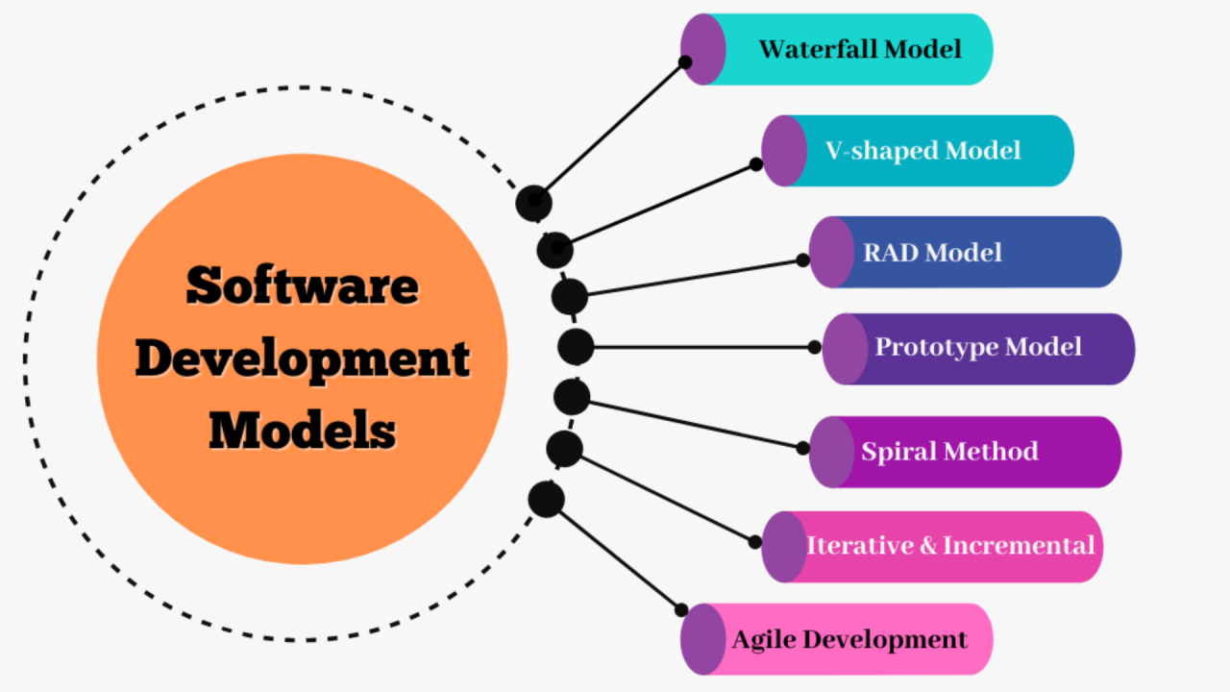
What is modelling?

Slide 117
Introduction to Modelling
Definition of Modelling:
Modelling is the process of creating a simplified representation of a system to understand, analyse, and communicate its structure and behavior.
Importance of Modelling:
Helps visualise complex systems
Facilitates communication among stakeholders
Serves as a blueprint for system development

Slide 118
Introduction to Modelling
Types of Models:
Conceptual Models:
High-level representation of concepts and relationships (e.g., ER diagrams)
Logical Models:
Detailed representation of system components and interactions (e.g., UML diagrams)
Physical Models:
Concrete implementation of the system (e.g., database schemas)

Slide 119
The Role of Modelling in IT Project
Visualisation of Complex Systems:
Models help stakeholders understand the overall architecture and flow of a system.
Facilitating Communication:
Common language for developers, clients, and project managers.
Documentation:
Models serve as a detailed record of system design and requirements.
Supporting System Analysis and Design:
Identify potential issues and optimise design before implementation.
Example: A conceptual model of an online bookstore showing entities such as Customers, Orders, and Books, and their relationships.

Slide 120
Modelling Techniques and Tools
Popular Modelling Techniques:
ER Diagrams: Represent entities and relationships in a database.
Flowcharts: Visualise process flows.
Data Flow Diagrams (DFD): Show data movement within a system.
Modelling Tools:
Lucidchart: Online diagramming tool for creating flowcharts and UML diagrams.
Microsoft Visio: Diagramming software for creating various types of diagrams.
Draw.io: Free online tool for creating diagrams and flowcharts.

Slide 121
What is UML?
Definition and History of UML:
UML (Unified Modelling Language) is a standardised modelling language developed by Object Management Group (OMG) in the 1990s.
Objectives of UML:
Provide a standard way to visualise the design of a system.
Facilitate communication and understanding among stakeholders.
Benefits of Using UML:
Improves clarity and accuracy in system design.
Supports various stages of software development.
Enhances collaboration and reduces ambiguity.

Slide 122
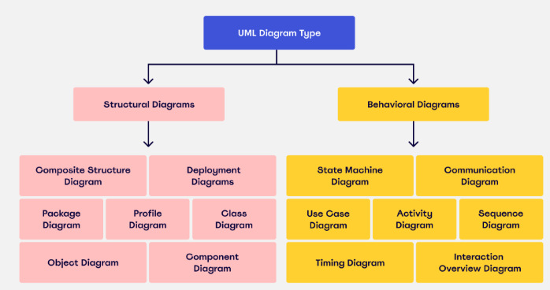
What is UML ? (Cont.)

Slide 123
What is UML: The UML Framework
UML provides a comprehensive framework for modelling software systems.
Structure of UML Diagrams:
Structural Diagrams: Represent static aspects of the system.
Behavioral Diagrams: Represent dynamic aspects of the system.
Different Types of UML Diagrams:
Structural Diagrams: Class Diagram, Object Diagram, Component Diagram, Deployment Diagram.
Behavioral Diagrams: Use Case Diagram, Sequence Diagram, Activity Diagram, State Diagram.

Slide 124
What is UML: UML Diagrams Classification
Structural Diagrams:
Class Diagram: Shows classes, attributes, methods, and relationships.
Component Diagram: Depicts components and their interconnections.
Behavioral Diagrams:
Use Case Diagram: Represents the interactions between users and the system.
Sequence Diagram: Visualises the sequence of messages between objects.
Activity Diagram: Illustrates the flow of activities in a system.

Slide 125
Use Case Diagrams
Definition and Purpose:
Use case diagrams model the interactions between users (actors) and the system.
Key Components:
Actors: Represent roles that interact with the system (e.g., users, external systems).
Use Cases: Describe the system's functionality from an external perspective.
System Boundary: Defines the scope of the system.
Relationships:
Include: A use case includes the behavior of another use case.
Extend: A use case extends the behavior of another use case under certain conditions.
Generalisation: An actor or use case inherits the behavior of another actor or use case.

Slide 126
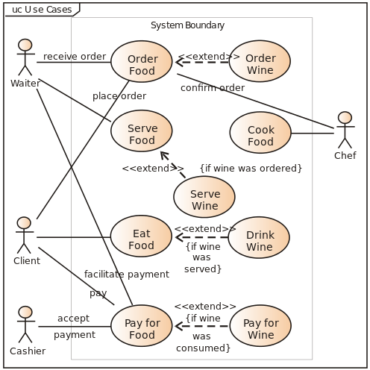
Use Case Diagrams

Slide 127
Use Case Diagrams: How to Create it?
Steps to Create a Use Case Diagram:
Identify actors interacting with the system.
Define the use cases representing the system's functionality.
Draw the system boundary.
Establish relationships between actors and use cases.
Practical Example:
ATM System Use Case Diagram:
Actors: Customer, Bank
Use Cases: Withdraw Cash, Check Balance, Transfer Funds
Relationships: Customer includes Withdraw Cash and Check Balance

Slide 128

Use Case Diagrams: How to Create it?(Cont.)
Steps to Create a Use Case Diagram:
Identify actors interacting with the system.
Define the use cases representing the system's functionality.
Draw the system boundary.
Establish relationships between actors and use cases.
Practical Example:
ATM System Use Case Diagram

Slide 129
Use Case Diagrams: How to Create it? (Cont.)
Explanation:
Actors:
Customer: Represents the person using the ATM machine.
Bank: Represents the bank's backend system interacting with the ATM.
Use Cases:
Withdraw Cash: Allows the customer to withdraw cash from their account.
Check Balance: Allows the customer to check their account balance.
Transfer Funds: Enables the customer to transfer money between accounts.
Deposit Cash: Allows the customer to deposit cash into their account.
Relationships:
Customer - Withdraw Cash: The customer interacts with the ATM to withdraw cash.
Customer - Check Balance: The customer interacts with the ATM to check their account balance.
Customer - Transfer Funds: The customer uses the ATM to transfer funds between accounts.
Customer - Deposit Cash: The customer uses the ATM to deposit cash into their account.

Slide 130
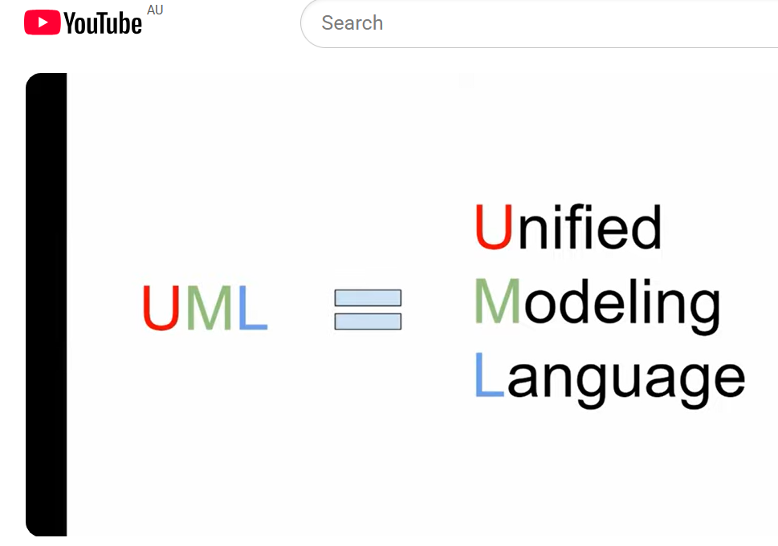
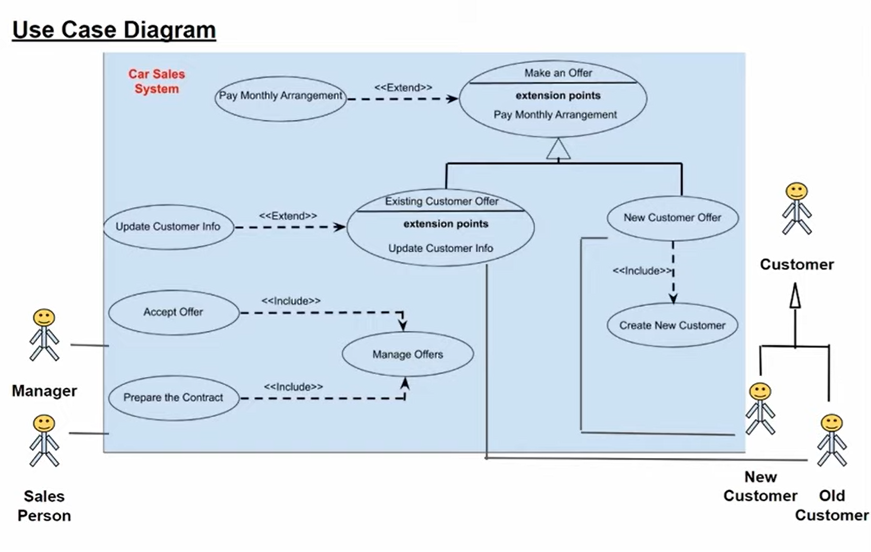
Example:
A Use Case Diagram shows:
Who uses the system (actors)
What they do (use cases)
How they interact with the system
https://youtu.be/hF4yg1yFrdU?si=fqXFLMchXeptHhWJ

Slide 131
This diagram shows who uses the system and what they do.
Actors (people):
Customer
Manager
Sales Person
System:
Car Sales System (the big box)
Use cases (actions):
Make an offer
Accept offer
Update customer info
Create new customer
Manage offers
Prepare contract

Slide 132
In simple terms:
A customer can request or receive an offer.
A sales person helps manage offers and prepares contracts.
A manager may approve or handle offers.
Some actions depend on others:
“Create New Customer” is included when dealing with a new customer.
“Update Customer Info” extends existing customer actions.

Slide 133
Why this fits BIS / IT Governance:
It shows:
Business processes (sales, offers, contracts)
Roles and responsibilities
How an IT system supports business activities
That’s exactly what business information systems are about—using IT to support business operations.

Slide 134
This is a Car Sales System.
Actors (people)
Customer
New Customer
Old Customer
Manager
Sales Person
These are the users of the system

Slide 135
Use cases (actions)
Make an Offer
Accept Offer
Prepare Contract
Update Customer Info
Create New Customer
Manage Offers
Pay Monthly Arrangement
These are things users do in the system

Slide 136
Relationships (important but simple)
1. «include»
Means: This step always happens
Example:
Accept Offer → includes → Manage Offers You cannot accept an offer without managing offers

Slide 137
2. «extend»
Means: This step is optional / happens sometimes
Example:
Pay Monthly Arrangement → extends → Make an Offer Only happens if customer chooses payment plan

Slide 138
3. Generalisation (inheritance)
New Customer and Old Customer are types of Customer

Slide 139
3. Generalisation (inheritance)
New Customer and Old Customer are types of Customer

Slide 140
Software Development)
Task: Draw a use case diagram for an online shopping system.
Include:
Customer
Add to Cart
Checkout
Pay
Students should:
Identify actors
Draw system boundary
Connect actions

Slide 141
IS + IT Governance)
Task: Explain how a car sales system helps a business.
Students can talk about:
Managing customers
Tracking sales
Improving efficiency
Reducing errors
Supporting decisions

Slide 142
Class Diagrams
Definition and Purpose:
Class diagrams represent the static structure of a system by showing its classes, attributes, methods, and relationships.
Key Components:
Classes: Represented as rectangles with three compartments: name, attributes, and methods.
Attributes: Characteristics of a class.
Methods: Functions or operations of a class.
Relationships: Association, aggregation, composition, inheritance.

Slide 143
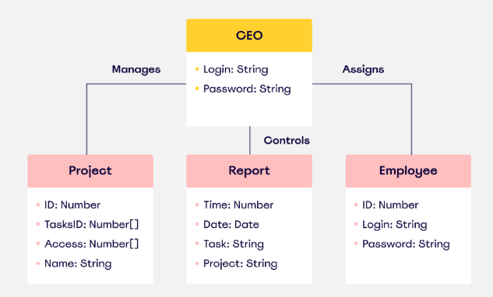
Class Diagrams

Slide 144
Class Diagrams: How to Create it?
Steps to Create a Class Diagram:
Identify the classes needed for the system.
Define the attributes and methods for each class.
Establish relationships between classes.
Practical Example:
E-commerce System Class Diagram:
- Classes: Customer, Order, Product, ShoppingCart
- Attributes: Customer (name, email), Product (name, price)
- Methods: Order (placeOrder(), cancelOrder())

Slide 145
Sequence Diagrams
Definition and Purpose:
Sequence diagrams represent the sequence of messages exchanged between objects over time.
Key Components:
Objects: Represented as rectangles with lifelines extending vertically.
Lifelines: Dotted lines representing the object's existence over time.
Messages: Arrows showing communication between objects.
Activations: Bars indicating the period an object is active.

Slide 146
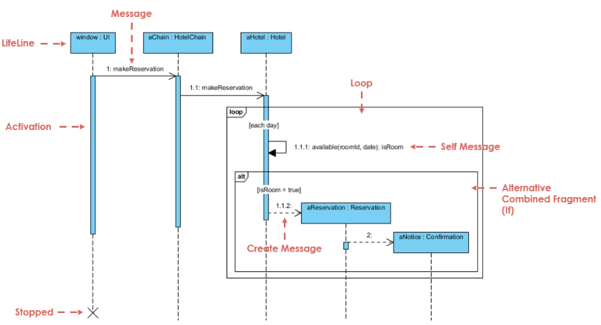
Sequence Diagrams

Slide 147
Sequence Diagrams: How to Create it?
Steps to Create a Sequence Diagram:
Identify the objects involved in the interaction.
Define the sequence of messages exchanged between objects.
Draw the objects, lifelines, messages, and activations.
Practical Example:
Online Shopping Sequence Diagram:
-Objects: Customer, ShoppingCart, PaymentGateway
-Messages: addItem(), checkout(), processPayment()

Slide 148
Activity Diagrams
Definition and Purpose:
Activity diagrams illustrate the flow of activities in a system, highlighting the sequence and conditions of workflows.
Key Components:
Activities: Represented as rounded rectangles.
Transitions: Arrows showing the flow from one activity to another.
Decisions: Diamonds representing branching points.
Start/End Points: Circles indicating the start and end of the workflow.

Slide 149
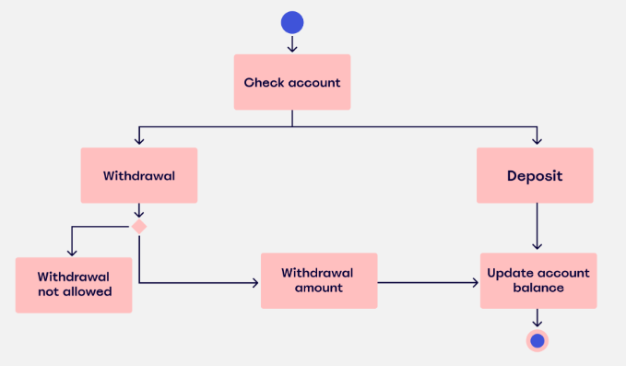
Activity Diagrams

Slide 150
Activity Diagrams: How to Create it?
Steps to Create an Activity Diagram:
Identify the activities involved in the workflow.
Define the sequence of activities and decisions.
Draw activities, transitions, decisions, and start/end points.
Practical Example:
Order Processing Activity Diagram:
- Activities: Receive Order, Verify Payment, Process Order, Ship Order
- Transitions: From Receive Order to Verify Payment, from Verify Payment to Process Order, from Process Order to Ship Order
- Decisions: Payment Verification Successful or Failed

Slide 151
Best Practices in Choosing UML Diagrams in IT Projects
Tailoring UML Diagram Selection:
Project Phase: Select diagrams based on the current phase of the project (e.g., requirements gathering, design, implementation).
Audience: Consider the audience who will use and benefit from the diagrams (e.g., developers, project managers, stakeholders).
Iterative Development: Update and refine diagrams as the project progresses to reflect changes and new insights.

Slide 152
Best Practices in Choosing UML Diagrams in IT Projects
Integration with Agile Practices:
Adaptability: Use lightweight diagrams that support agile methodologies and frequent iterations.
Collaboration: Encourage collaboration among team members through shared understanding facilitated by UML diagrams.

Slide 153
Group Discussion Case Study 1
Scenario 1: Use Case Diagram for an E-commerce Platform
Scenario: You are tasked with developing a Use Case Diagram for an upcoming e-commerce platform project. Stakeholders include project managers, developers, and marketing teams.
Questions:
Which actors would you identify for the e-commerce platform?
What are some primary use cases that should be included in the diagram?
How would you ensure the diagram reflects interactions between different user roles and system functionalities?

Slide 154
Case Study 1: Discussion Points
Actors: Customer, Administrator, Marketing Manager
Use Cases: Browse Products, Add to Cart, Checkout, Manage Orders
Relationships: Customer interacts with all use cases; Administrator manages product listings; Marketing Manager oversees promotional activities.

Slide 155
Group Discussion Case Study 2
Scenario 2: Class Diagram for a Banking System
Scenario: You are leading the design phase of a new banking system. The system needs a robust Class Diagram to depict relationships between different entities such as Account, Transaction, and Customer.
Questions:
What are some essential classes and their attributes in the banking system?
How would you model relationships between classes like Account, Transaction, and Customer?
Why is it important to include inheritance and associations in the Class Diagram?

Slide 156
Case Study: Discussion Points(Cont.)
Classes: Account (Account Number, Balance), Transaction (Transaction ID, Amount), Customer (Customer ID, Name)
Relationships: Account has Transactions; Customer has Accounts; Inheritance for different account types (e.g., SavingsAccount, CheckingAccount).
Importance: Clarifies data structure, supports system scalability, and guides database schema design.

Slide 157
Summary
Understanding Project Requirements: Start with thorough analysis and stakeholder engagement to define scope.
Selection Criteria: Choose UML diagrams based on system complexity and information dynamics.
Common Diagrams: Use Case, Class, Sequence, and Activity diagrams serve various modelling needs.
Best Practices: Tailor diagram selection to project phase and audience, supporting iterative development.

Slide 158
Q&A
Question?

